Slide 1
August 15th Meeting
Ainsley Lai

Slide 2
Agenda
Source Level vs. Speed
From literature, we know that the relation w/ range is log so we investigate the relation w/ speed

Slide 3
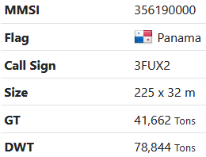
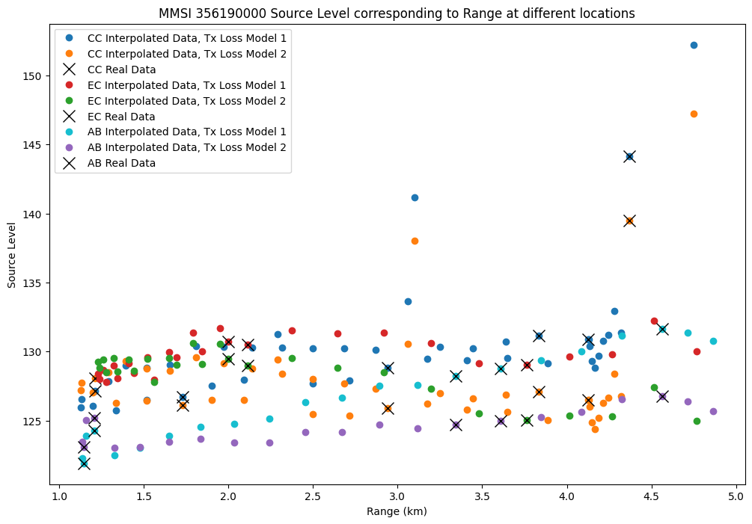
MMSI 356190000 Source vs. Range

Slide 4
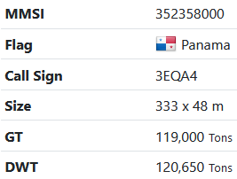
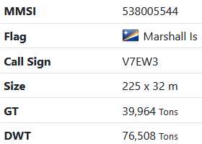
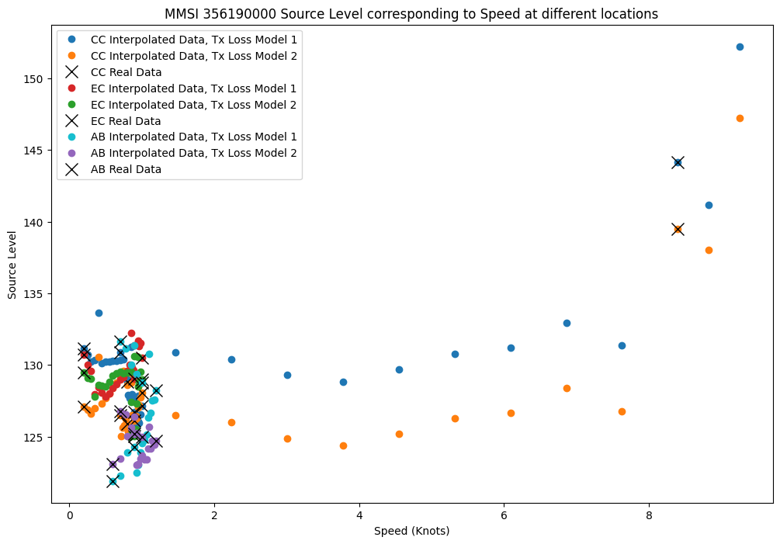
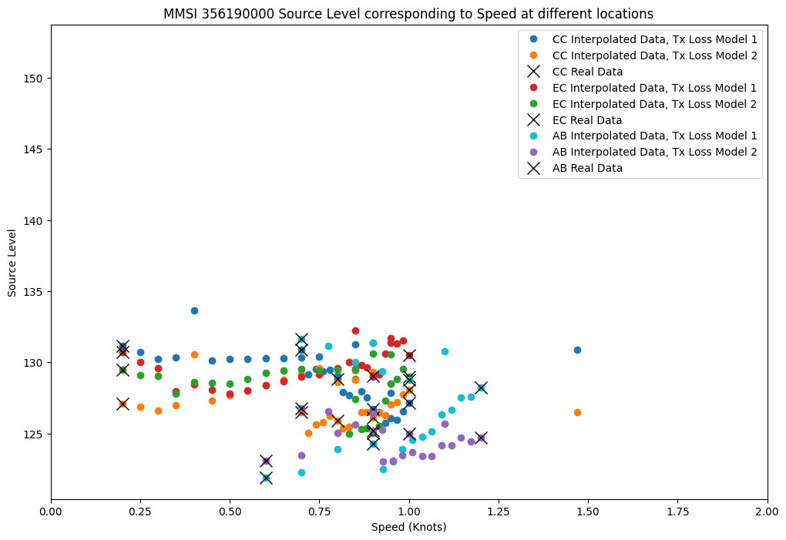
MMSI 356190000 Source vs. Speed
Lower Speed

Slide 5
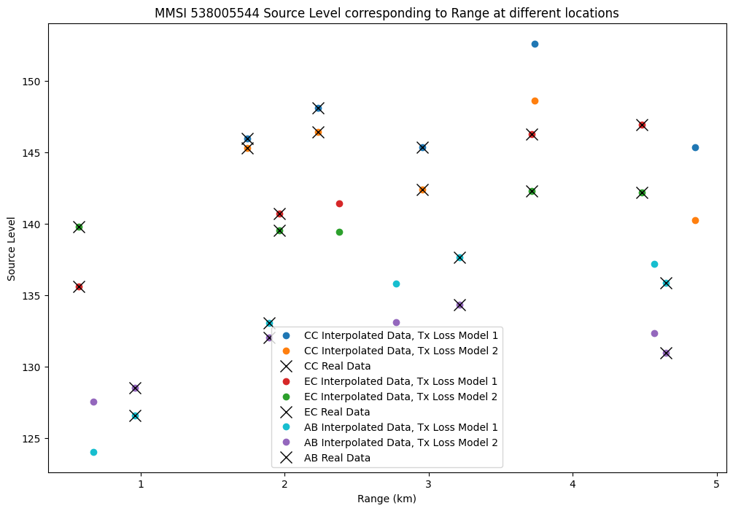
MMSI 538005544 Source vs. Range

Slide 6
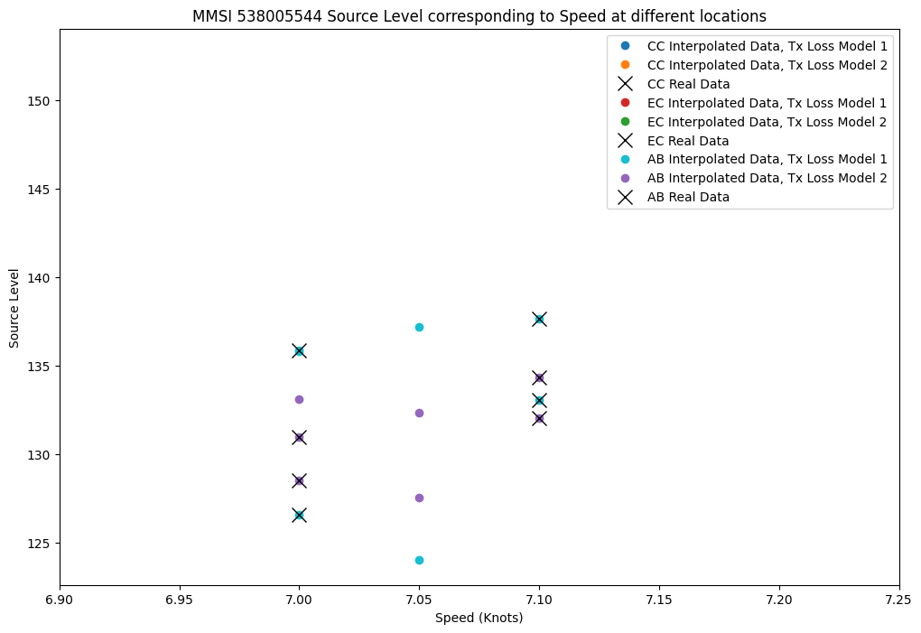
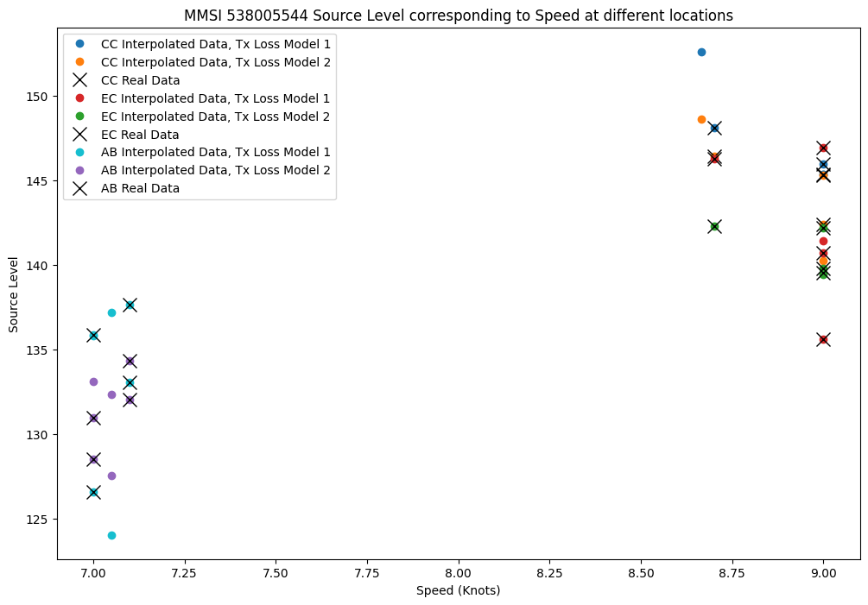
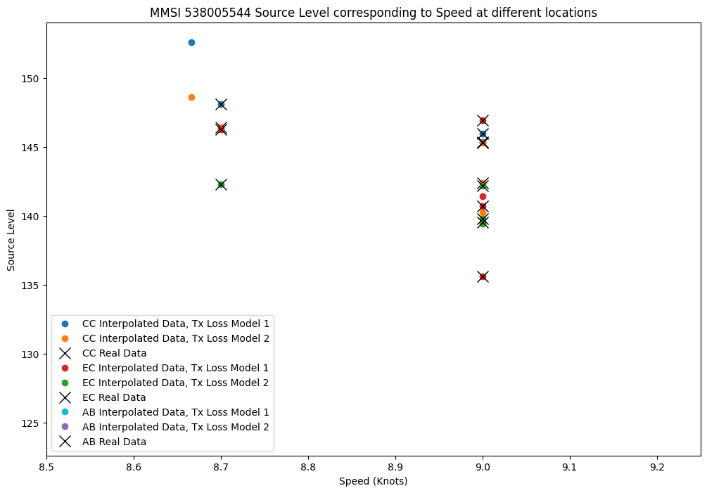
MMSI 538005544 Source vs. Speed
Lower Speed
Higher Speed

Slide 7
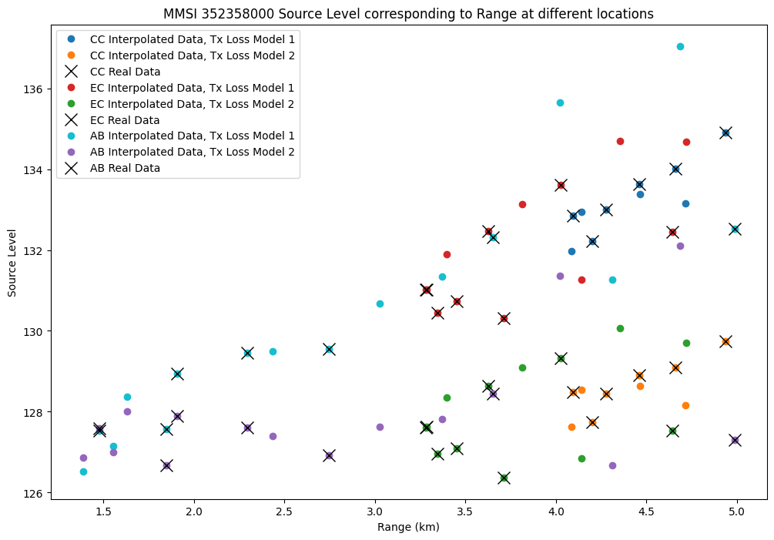
MMSI 352358000 Source vs. Range

Slide 8
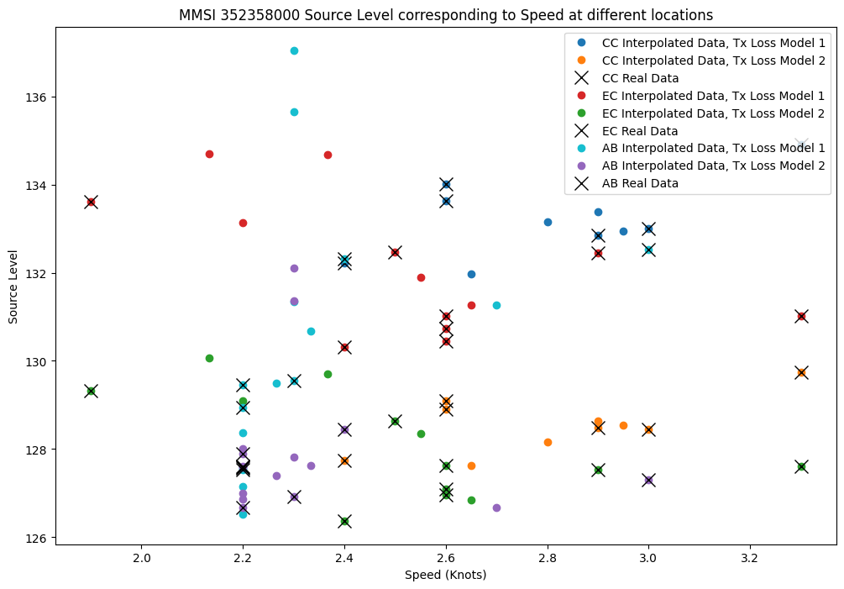
MMSI 352358000 Source vs. Speed
Data taken at small range at low speeds (~2-3 knots)

